Slide 1
NB-IoT Technology
Hakim MABED

Slide 2
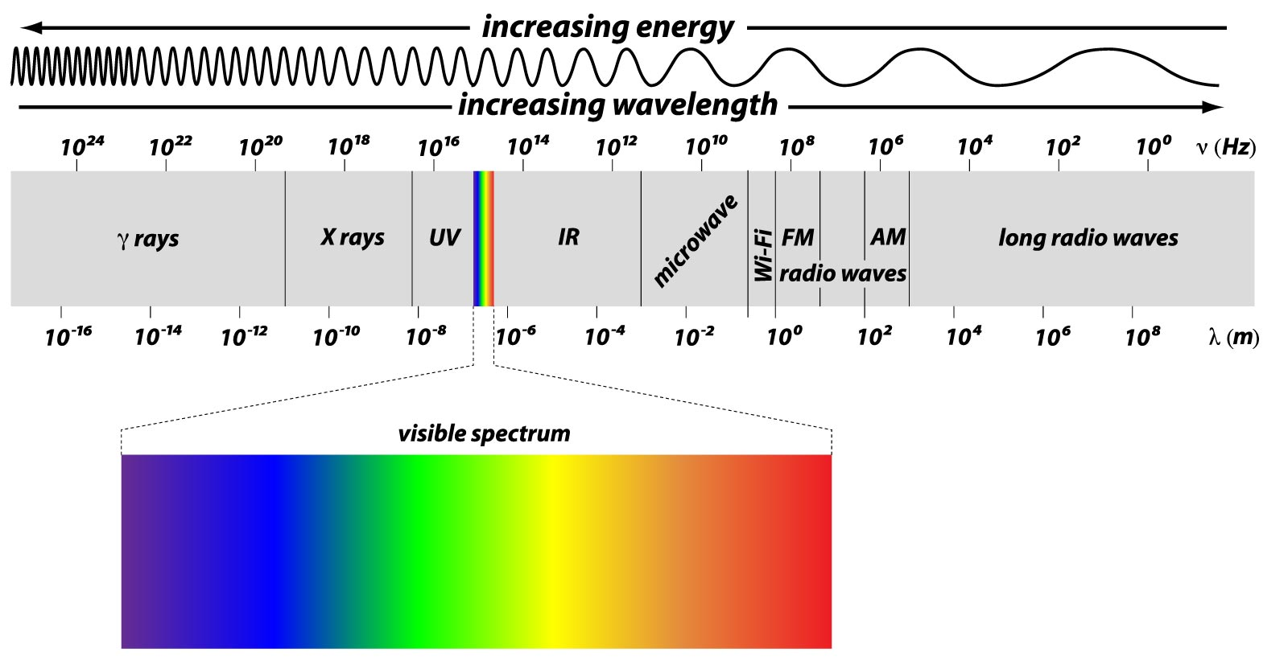
Licensed vs unlicensed radio networks
Licensed radio networks
The exploitation of the frequencies dedicated to such technology is subject to authorization
Example : GSM, UMTS, LTE, 5G NR
Unlicensed radio networks
The exploitation of the technology and the related frequencies is free
Example : LoRA, Bluetooth, SigFox, WiFi

Slide 3
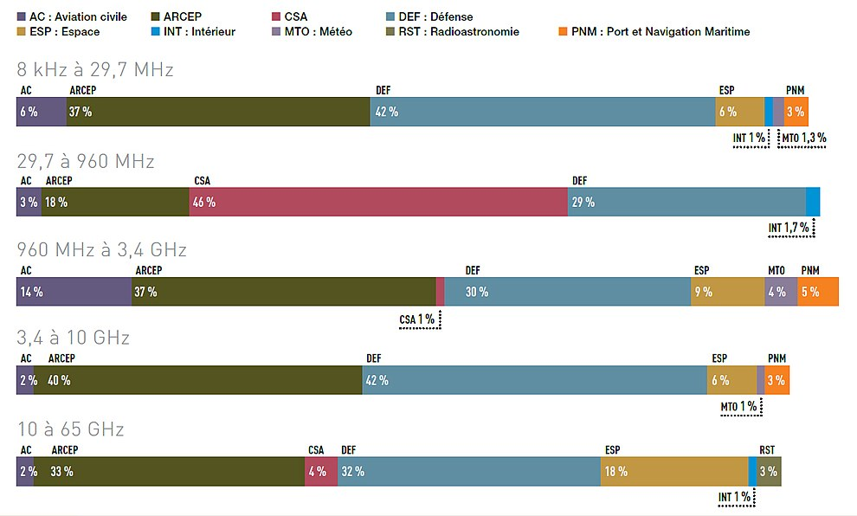
Frequency management in France

Slide 4
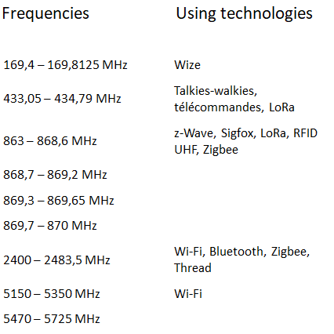
Unlicensed Frequencies in France
Gaz and electrecity counter

Slide 5
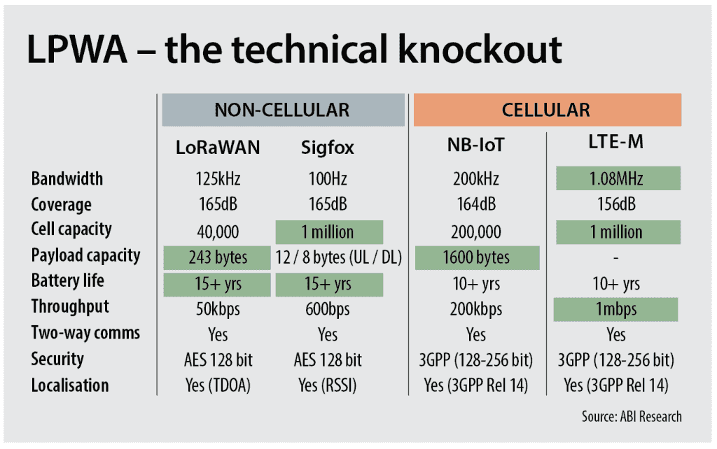
NB-IOT
NB-IOT : Narrow Band IoT
Objectif : support IoT application using LTE infrastructure
Reduce deployment cost
Adapted to low data rate requirements
Adapted to low power constraints (LPWA -> UE power transmission 14dBm = 0,025watt)

Slide 6
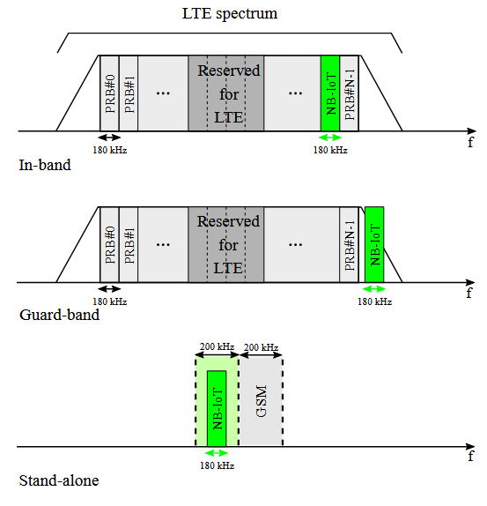
What’s new in NB-IOT
Three modes for integrating NB-IOT technology
In-band mode : one or several PRB (12 x 15 kHz) of the LTE are dedicated to NB-IoT
Guard-band mode : NB-IoT communication uses a PRB (12 x 15 kHz) from the unused guard band PRBs of LTE bandwidth.
Stand-alone mode : NB-IOT communication uses a frequency sub-band from the GSM spectrum (200kHz)

Slide 7
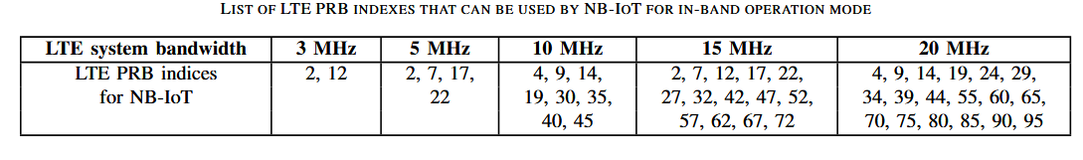
NB-IOT integration in LTE
According to the LTE system bandwidth, the number of PRBs dedicated to NB-IOT differs (In-band mode):
UE side operates in a type B half-duplex FDD (HD-FDD) mode : uplink and downlink communications operate in different frequencies, however due to the power reduction constraints, the UE cannot be in reception and transmission mode simultaneously.
Since Release 15, NB-IoT can operate in TDD mode

Slide 8
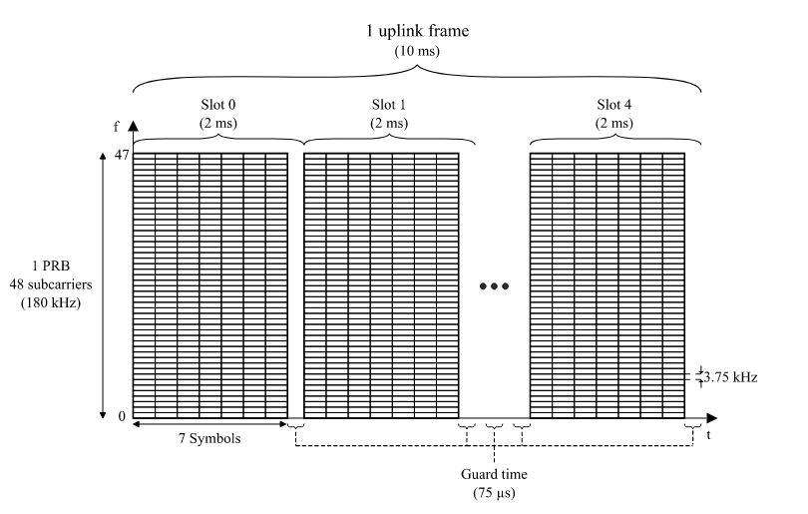
NB-IOT uplink time-division
While the time-organization in the Downling remains
the same as in LTE,
In the uplink there is two modes :
15kHz subacrriers : similar to LTE
3,75Khz subcarriers :
one slot = 2 ms
one frame = 10 ms = 5 slots
1 PRB = 48 subcarriers (SC-FDMA)
1 subcarrier = 3,75 kHz

Slide 9
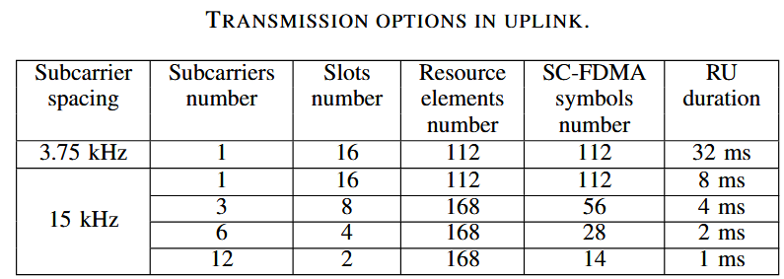
NB-IOT Uplink transmission options
There are two transmission mode :
single tone (one subcarrier)
multiple tones (one or several subcarriers)
With 3,75kHz subcarriers, only single tone
option is possible (1 subcarrier / 48 in the PRB).
With 15kHz subcarriers, UE can sends data over 1, 3, 6 or 12 subcarriers / 12 in the PRB)
The elementary resource (minimal number of consecutive slots) depends on the subcarrier spacing and the subcarriers number,

Slide 10
New channels of NB-IOT
Two new uplink channels :
NPRACH: UE transmits preambles through the NPRACH to trigger the connection with the eNB. The detection of such preambles is essential in order to identify any UE trying to join the network.
NPUSCH: carries the data sent from the IoT device to the eNB

Slide 11
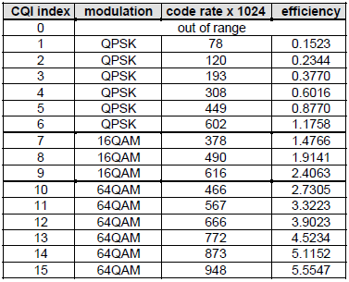
Map between radio quality and communication quality

